Slide 1
Project requirement
Task 1: Detecting the number in electric meter
Task 2: Detecting the number of electric meter

Slide 2
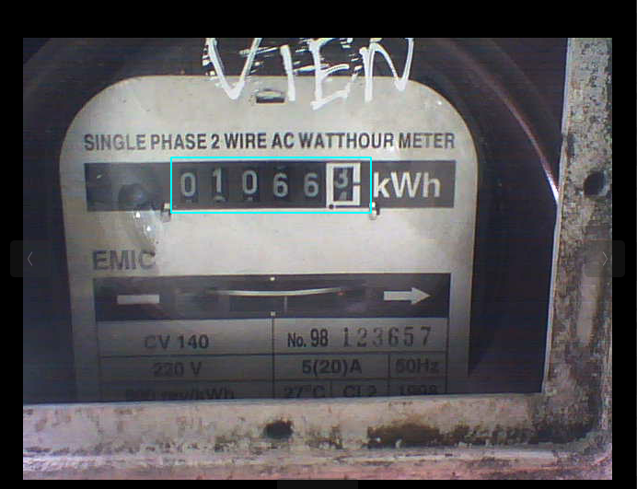
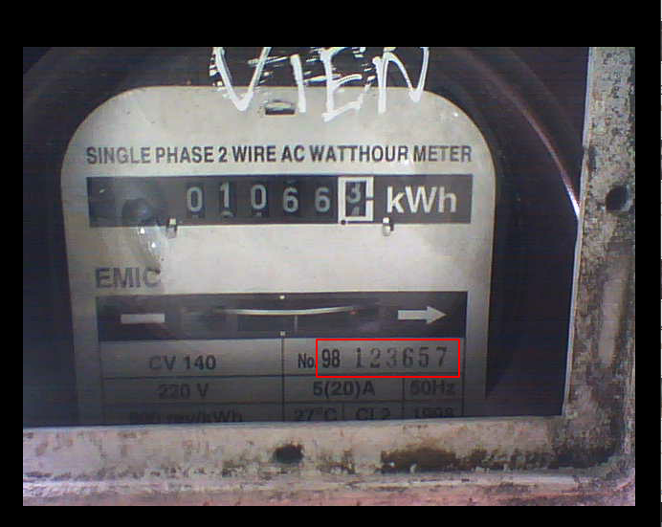
Project requirement
Task 1: 010663
Task 2: 98123657

Slide 3
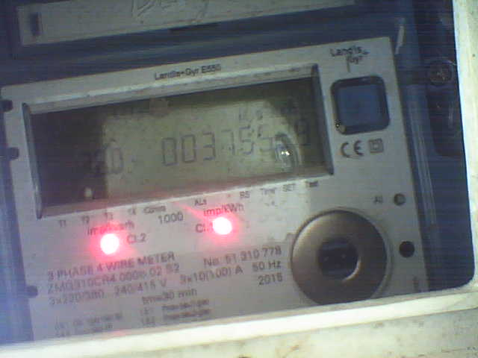
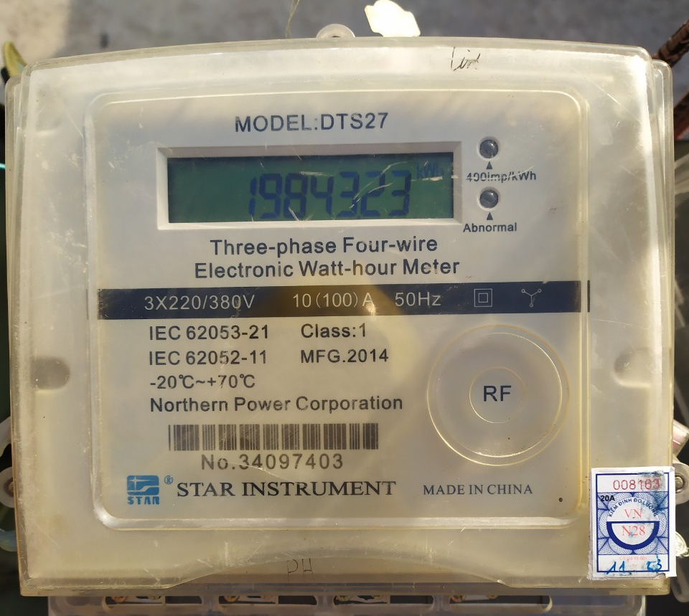
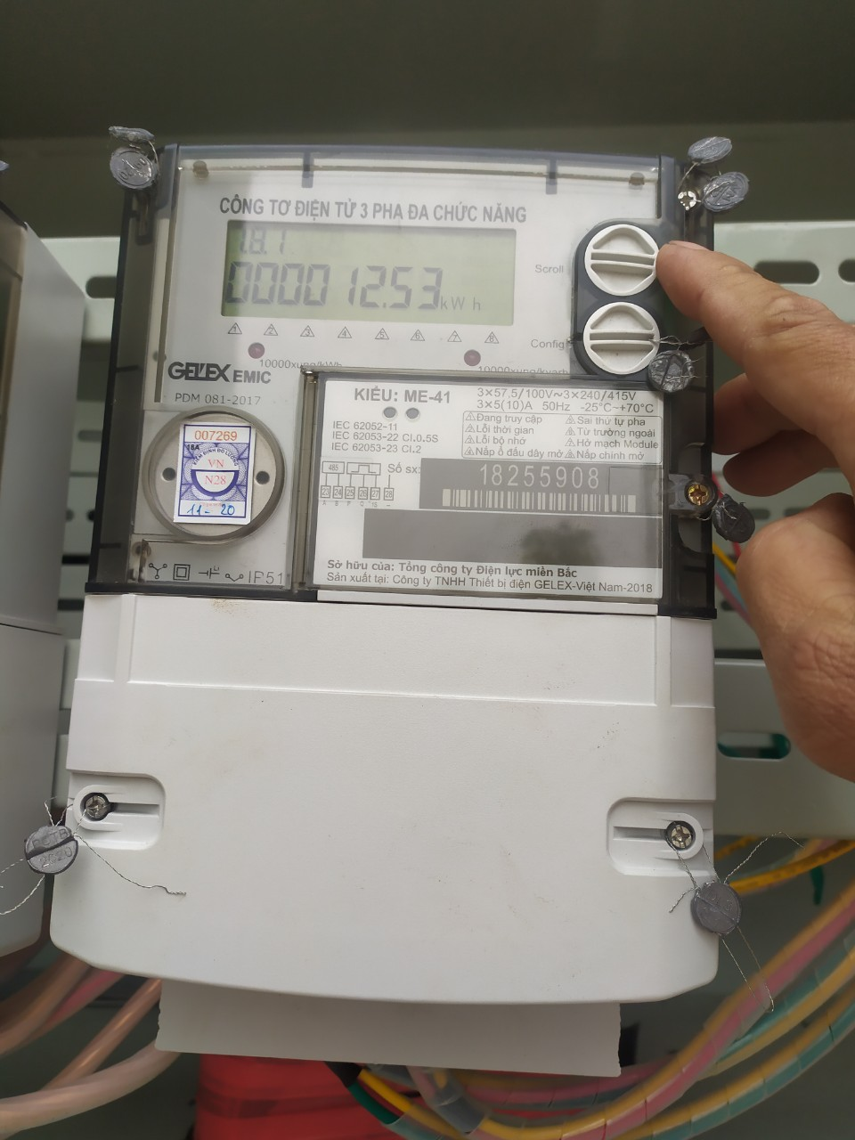
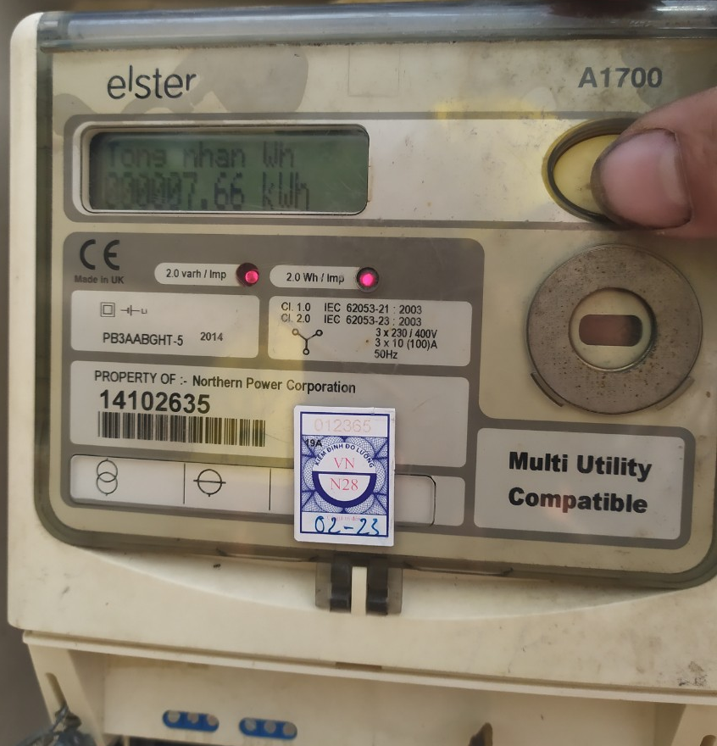
Project requirement
\
Analog metric
Digital metric

Slide 4
Project requirement

Slide 5

Project problem
3
Characters recognition

Slide 6
Project problem
1
2
3
4
Image processing
Number plate detecting
Segmentation
Characters recognition

Slide 7
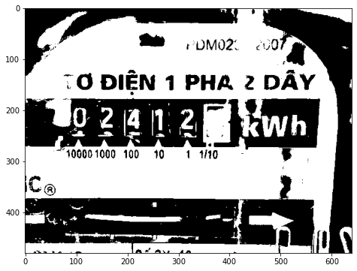
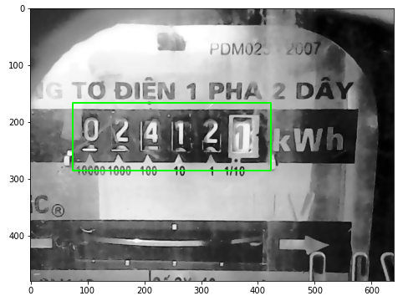
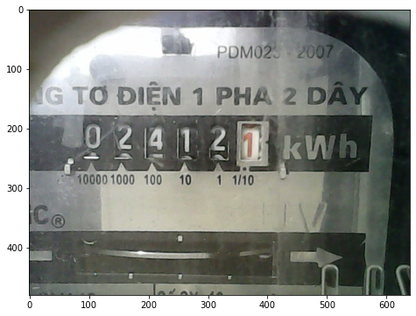






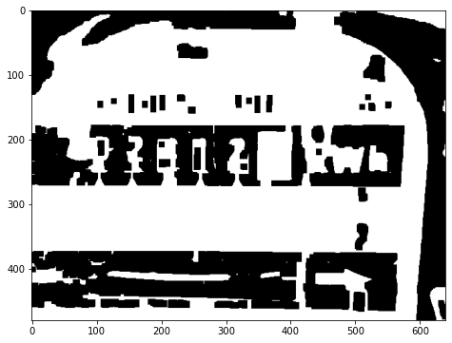

Project problem
024121
Image processing
Number plate detecting
Segmentation
Characters recognition

Slide 8
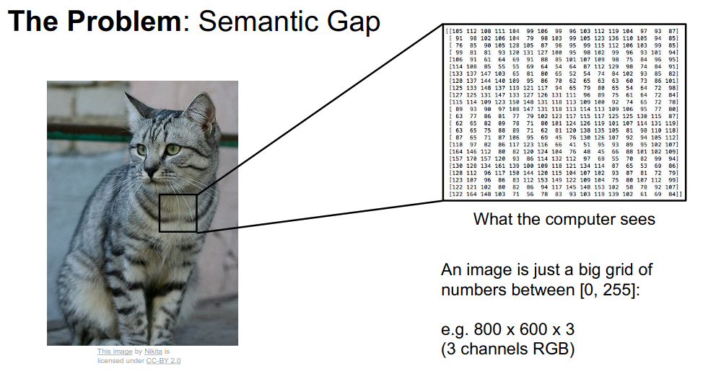

Slide 9
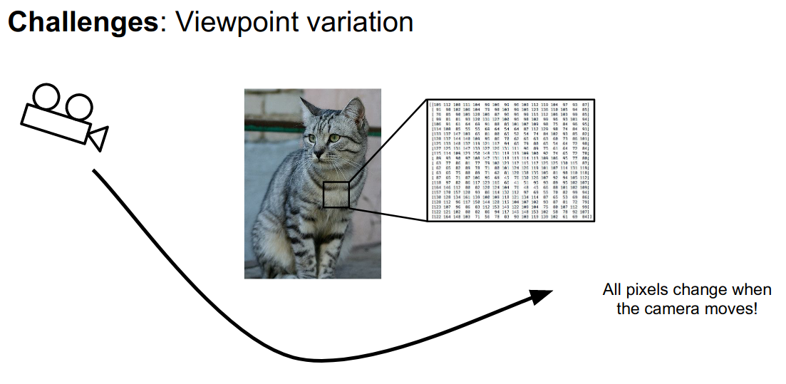

Slide 10





Slide 11
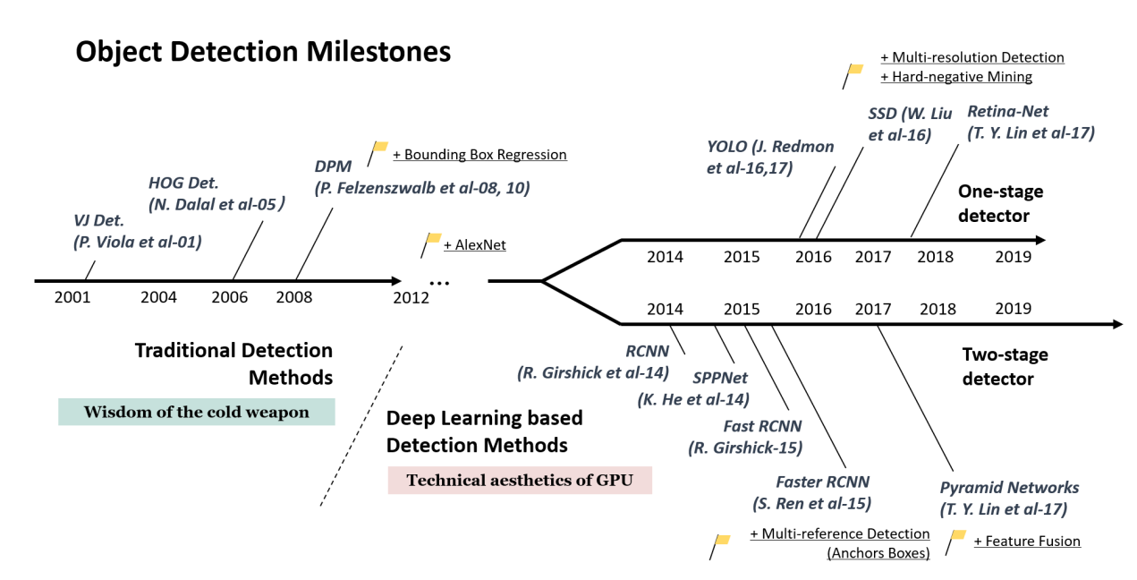
Advantageous

Slide 12
Advantageous
demo

Slide 13
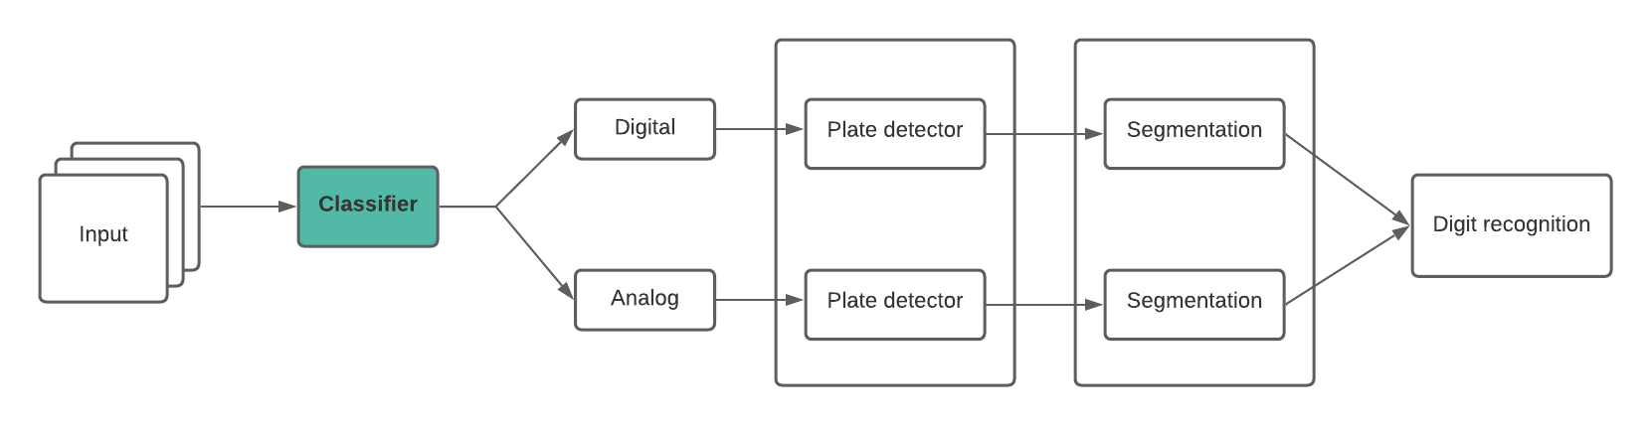
Model architecture

Slide 14
TODO:
Label

Slide 15
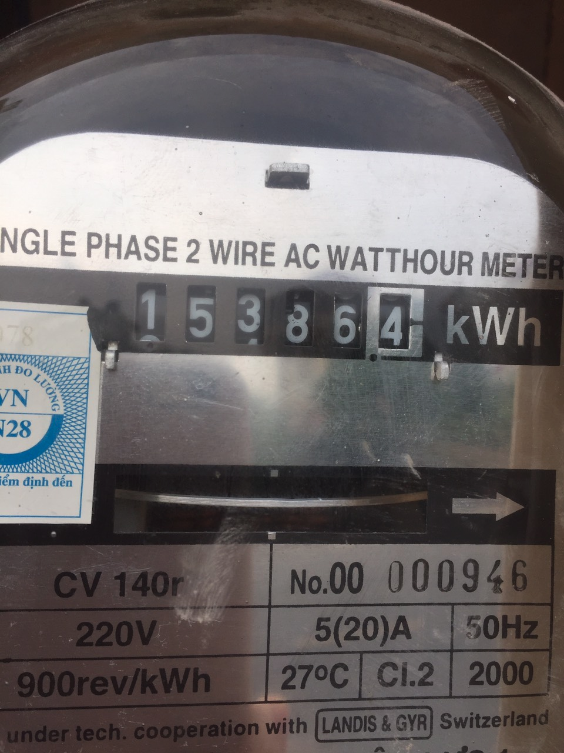
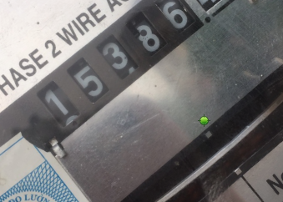
TODO:
Label
Data augmentation

Slide 16
TODO:
Label
Data augmentation
Training

Slide 17
TODO:
Label
Data augmentation
Training
Evaluate

